Slide 1

AI Challenge – Boston Housing
Francisco Simões

Slide 2

The Problem
Estimate house prices in the Boston area, using machine learning methods.

Slide 3
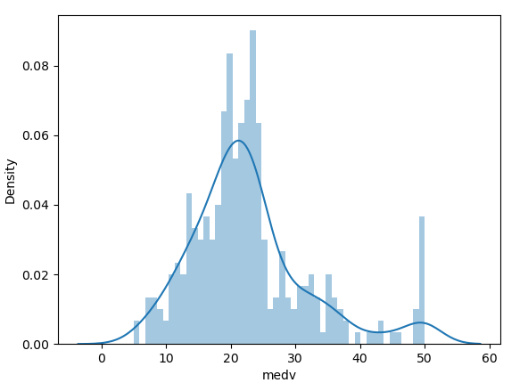

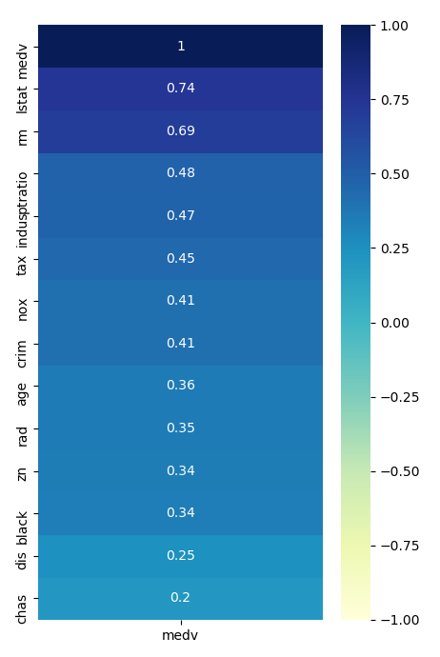
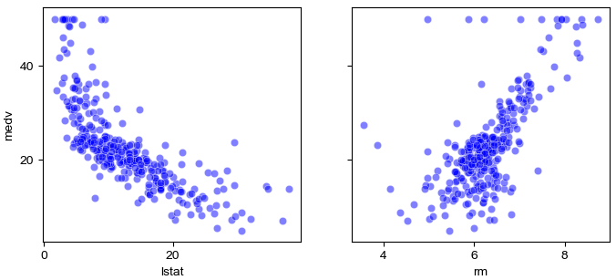
The Data

Slide 4
The Methods
Linear Regression
Lasso Regression
Decision Trees
Deep Neural Networks

Slide 5
The Results
RMSE: | Mean | Median | 25-percentile | 75-percentile
Decision Trees | 5.00 | 5.03 | 4.37 | 5.51
Linear Regression | 5.26 | 5.26 | 4.93 | 5.55
Lasso Regression | 5.64 | 5.64 | 5.34 | 5.96
Deep Neural Networks | 12.42 | 9.99 | 8.91 | 12.47
best to worst

Slide 6
The Results - example
Observation Value | 20.10
Decision Trees | 19.30
Linear Regression | 20.08
Lasso Regression | 19.70
Deep Neural Networks | 20.59

Slide 7
The Conclusions
We would recomend using Linear Regression or Decision Trees in this context.
We would not recomend using Deep Neural Networks due to it’s black blox nature.

